Slide 1

HOPE FOUNDATION’s International Institute of Information Technology
Project Based Seminar
On
“Proxy Detection with Multistage Encryption using QR Code based Attendance System”
Class: BE IT SEM: VII
Academic Year: 2021-22
Guide: Prof. Manjusha Amritkar
Students Name: Yash Jane, Amey Potnurwar, Siddhi Agarwal, Sneha Dixon

Slide 2
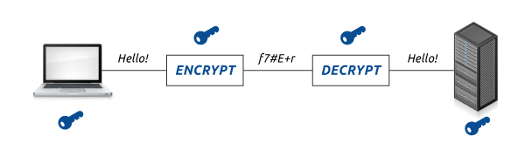
Problem Statement
“Proxy Detection with Multistage Encryption using QR Code based Attendance System”

Slide 3
Purpose
To prevent any malpractices and unauthorized access to digital information.
Allows to achieve complete security across all devices, send and receive data safely and guarantee absolute integrity.
By using this application users are not allowed to mark their proxy.
Data privacy is also important because in order for individuals to be willing to engage online, they have to trust that their personal data will be handled with care. Organizations use data protection practices to demonstrate to their customers and users that they can be trusted with their personal data.

Slide 4
Scope
It focuses on the security of key also as keys are the primary target of the attackers. It proposes to use multistage encryption, as it focuses on the strength to withhold the attack and maintain integrity of data.
The idea of our project is to digitize the way attendance is taken in colleges and gives a more comfortable and easier experience while taking attendance. Tracking of attendance is entirely web-based so the data can be entered from anywhere you can access the internet.

Slide 5
Objectives
A web application for the teachers to generate the QR code and maintain the attendance record.
A web application for students to scan the QR code displayed on the screen and mark their attendance
To improve the security of the common key used for encryption/ decryption as we intend to implement it using Binary-bit sequence.
Algorithm should be easier to implement at the same time it should be nuisance for the attackers to get it cracked.

Slide 6
Abstract
Currently for a secured communication to take place it has become important to use cryptography on both the sides i.e. encrypting data at sender’s side later followed by decryption processes at the receiver’s side.
It is difficult to provide security against the attackers, since they can easily get the significant data by uncovering the encryption key.
This scheme puts forward a new encryption/decryption algorithm that is based on the Binary-Bit sequence and further uses the XOR operation. It insinuates encryption at compound stages and the key is imparted by the user.
The proposed algorithm comes under the category of Symmetric key algorithms.

Slide 7
Project and Seminar Topics
Project Title : Encryption/ Decryption Scheme for Communications using Binary -bit Sequence and Multistage Encryption
Yash Jane : System Architecture
Amey Potnurwar : Logical Operations
Siddhi Agarwal : Design principles and concerns
Sneha Dixon : Comparative analysis and challenges

Slide 8
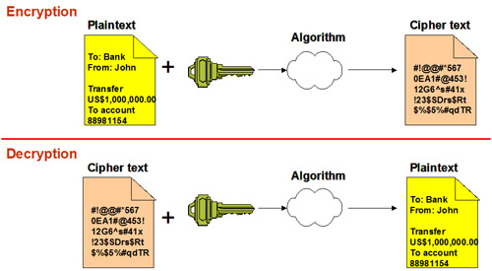
1. System Architecture
Introduction and System Overview

Slide 9
The previous diagram shows the process of Symmetric key encryption/ decryption algorithm.
The proposed scheme uses the same base-architecture as shown in the diagram. However, it uses bit sequence approach and encryption is carried out in multiple stages.
When sender uses a key to encrypt the plaintext data he/ she sends that same key with the ciphertext via a secure tunnel, and the recipient receives the key and the ciphertext after that key is feed to the decryption side of algorithm to unlock the encrypted message.
In Binary-bit sequence method, the binary data is split into small fragments which are referred to as the ‘sequence’.
Binary operation XOR is in consideration for the development in one of the stages as, XOR works as a cipher because it is its own inverse.
The method that the key that will be provided by the user should be from 0 to 255 is in consideration.

Slide 10
Literature Survey/ Related work
K.Govinda, E. Sathiyamoorth, “Multilevel Cryptography Technique Using Graceful Codes”, JGRCS - 2011, V2, No.7, PP 1-5
Ankur Singhal, Sumedha Kaushik, “Network Security Using Cryptographic Techniques”, IJARCSSE - 2012, ISSN: 2277 128X, V2, Issue 12, PP 105 – 107.
The Rjindael Block Cipher by Joan Daemen, Vincent Rijmen (Original creators of Rjindael Block Cipher popularly known as AES).
https://qvault.io/cryptography/why-is-exclusive-or-xor-important-in-cryptography/?ref=hackernoon.com
https://hackernoon.com/reasons-why-xor-is-important-in-cryptography-6tcn32yx
https://null-byte.wonderhowto.com/how-to/advanced-cryptography-total-guide-0168727/

Slide 11
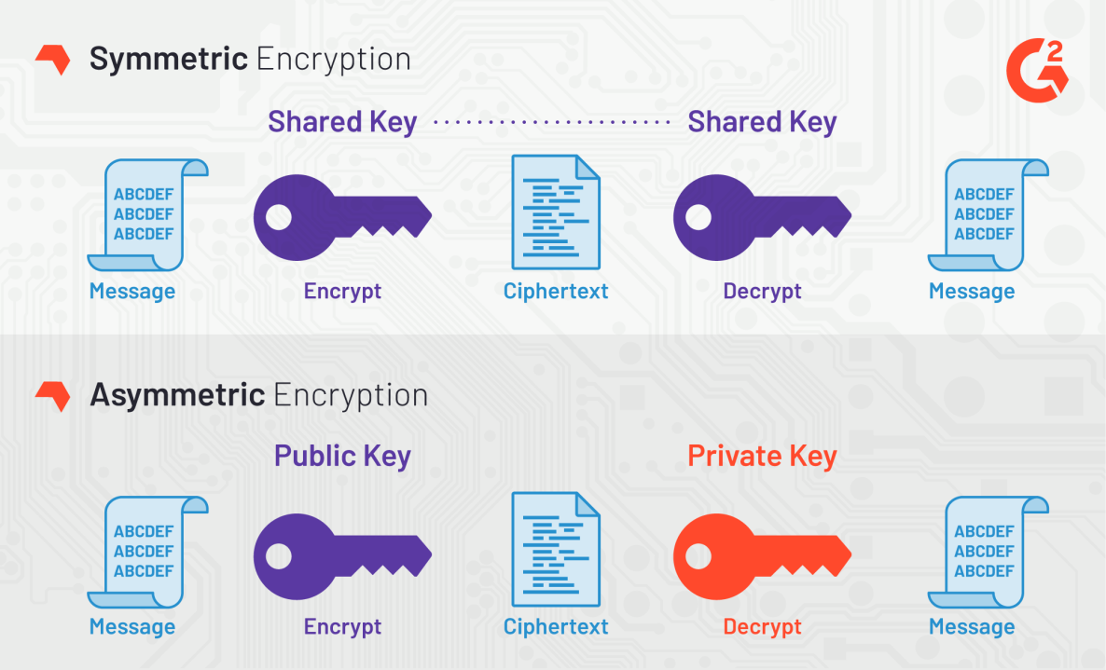
Why choose Symmetric not Asymmetric ?
Because the algorithm behind symmetric encryption is less complex and executes faster, this is the preferred technique when transmitting data in bulk.
The plaintext is encrypted using a key, and the same key is used at the receiving end to decrypt the received ciphertext. The host in the communication process would have received the key through external means.
Asymmetric encryption takes longer to execute because of the complex logic involved. For this reason, symmetric encryption is used when transmitting data in bulk.

Slide 12
Our proposed architecture…
Encryption | Decryption
Reading the plaintext message from user. | Read the cipher text from user.
Replacing the plaintext by encoding dictionary values. | Replace cipher text by their numerical values.
Read a secret key from the user. | Read the secret key form the user.
Perform the XOR of encoded values with the key provide by user. | Manage the binary bits sequence.
Convert numerical values in the binary n-bits sequence. | Perform the XOR operation of binary bits sequence and secret key.
Convert the received n-bit sequence in the n/2-bits binary sequence. | Perform reverse character substitution by referring the encoding dictionary.
Convert the n/2-bits binary sequence in the decimal format. | Process the plaintext.
Change all the decimal values with respective character from the character table. | Final OUTPUT
Transmit ciphertext

Slide 13
Applications
The light-weight design of the algorithm may enable it to pervade in many applications.
It can be used in the Web-apps and mobile apps that deals with sensitive information.
With the increasing IoT infrastructure it seems that this scheme will serve its purpose in IoT networks with some respective modifications.
Considering its simple and robust design it can be used in SSL and it has the scope for use in encrypting the keys of an Asymmetric algorithm.

Slide 14
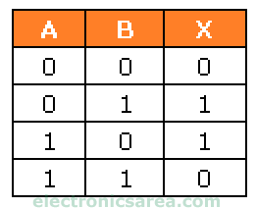
2. Logical Operations
In our proposed system we intend to use the Boolean operations.
One of the very famous Boolean operation is XOR i.e., Exclusive OR operation.
It is a very well known technique used in Symmetric key algorithms from long time. It holds a special place in mind of every Cryptographer.
XOR has its very own Boolean table from which we can understand why it is being used in even today’s latest encryption standards like AES. Following is the logic table for XOR operation.

Slide 15
Literature Survey/ Related work
A. Nath, S. Ghosh and M. A. Mallik, “Symmetric key Cryptography using Random Key Generator”, Proceedings of International conference on Security and Management.
Shaili Singhal, Dr. Niraj Singhal, “A Comparative Analysis of AES and RSA Algorithms”. International Journal of Scientific & Engineering Research.
https://www.cryptomathic.com/news-events/blog/summary-of-cryptographic-algorithms-according-to-nist
https://itstillworks.com/advantages-disadvantages-symmetrical-asymmetrical-encryption-2143.html
https://hackernoon.com/reasons-why-xor-is-important-in-cryptography-6tcn32yx

Slide 16
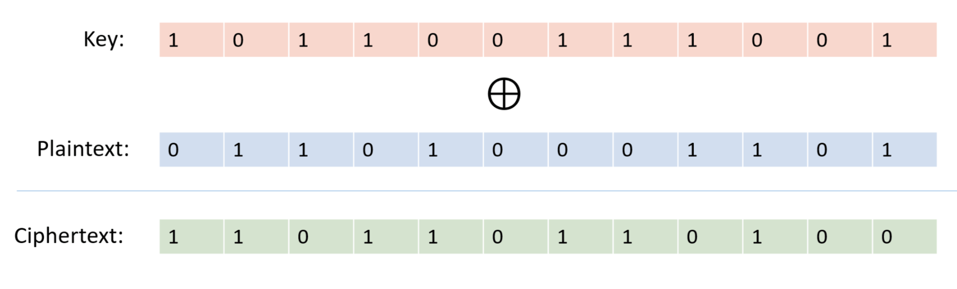
Why is Exclusive Or (XOR) Important in Cryptography?
XOR is a simple bitwise operation that allows cryptographers to create strong encryption systems, and consequently is a fundamental building block of practically all modern ciphers. Let’s dive into the details and see what makes XOR so important.
XOR, or “exclusive or” operates on binary data. It returns true if both of its inputs are opposites (one false and one true), otherwise, it returns false.

Slide 17
XOR Cipher – The Perfect Cipher
It is interesting to note that if:
The key is the same size as the message
The key is kept secret and generated truly randomly
Then the XOR cipher is certainly impossible to crack. This is known as a one-time pad.
NOTE: However, a simple XOR shouldn’t be used in production due to the key length needing to be too long to be practical.
It concludes that the key length should not be necessarily equal to plaintext. It can vary
And its very real-world example is WhatsApp.
If key length doesn’t match plaintext then padding will be added.
Therefore, in our proposed algorithm we intend to use the key length of 0 to 255
i.e., 128 bit key. And we intend to use 128 bit block of sequence. Again it can vary this is just an theoretical hypothesis, bit sequence length can only be decided on experimentation.

Slide 18
Cipher Example
For instance, let’s simply encrypt the word “hi”
1. First, convert “hi” to binary, here is a free tool: https://www.rapidtables.com/convert/number/ascii-to-binary.html)
01101000 01101001
2. Next, create a random secret key that has the same length:
01010010 01000101
3. Then, create an encrypted message by XOR’ing the message and the key:
01101000 01101001 ("hi") XOR 01010010 01000101 (secret key) = 00111010 00101100 (encrypted message)
4. Finally, decrypt the message by XOR’ing the key with the encrypted message again:
00111010 00101100 (encrypted message) XOR 01010010 01000101 (secret key) = 01101000 01101001 ("hi")

Slide 19
3. Design Principles and Concerns
Algorithm-
An algorithm is a finite list of instructions, most often used in solving problems or performing tasks.
Principle of Algorithm-
Availability (performance of algorithm)
Access Control (control use of algorithm)
Confidentiality (privacy on algorithm process)

Slide 20
Availability (performance of algorithm) Performance of an algorithm means predicting the resources which are required to an algorithm to perform its task.
Measure Performance of an Algorithm…
Algorithmic Efficiency
1.Time Efficiency
2.Space Efficiency
Time Efficiency: a measure amount of time for an algorithm to execute.
Space Efficiency: a measure amount of memory needed for an algorithm to execute.

Slide 21
Access Control (control use of algorithm)
Access Control is a fundamental component of data security that dictates who’s allowed to access and use company information and resources. Through authentication and authorization, access control policies make sure users are who they say they are and that they have appropriate access to company data.
Three Types Of Access Control
Discretionary Access Control (DAC)
Role Based Access Control (RBAC)
Mandatory Access Control (MAC)

Slide 22
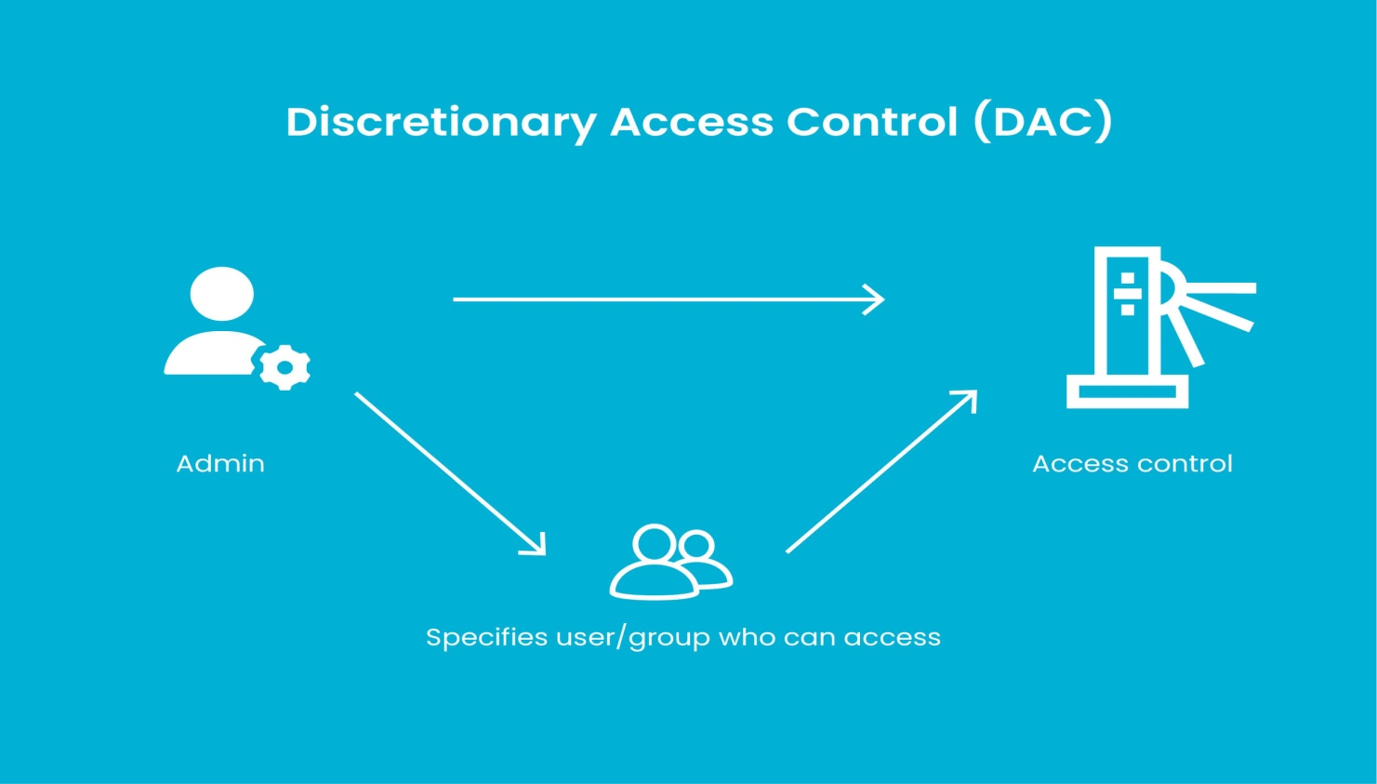
Discretionary Access Control (DAC) Under this category of Access Control Management, the business owner is responsible for managing access permissions. The operating system in this case does not decide to allow for deny entry based on any criteria.

Slide 23
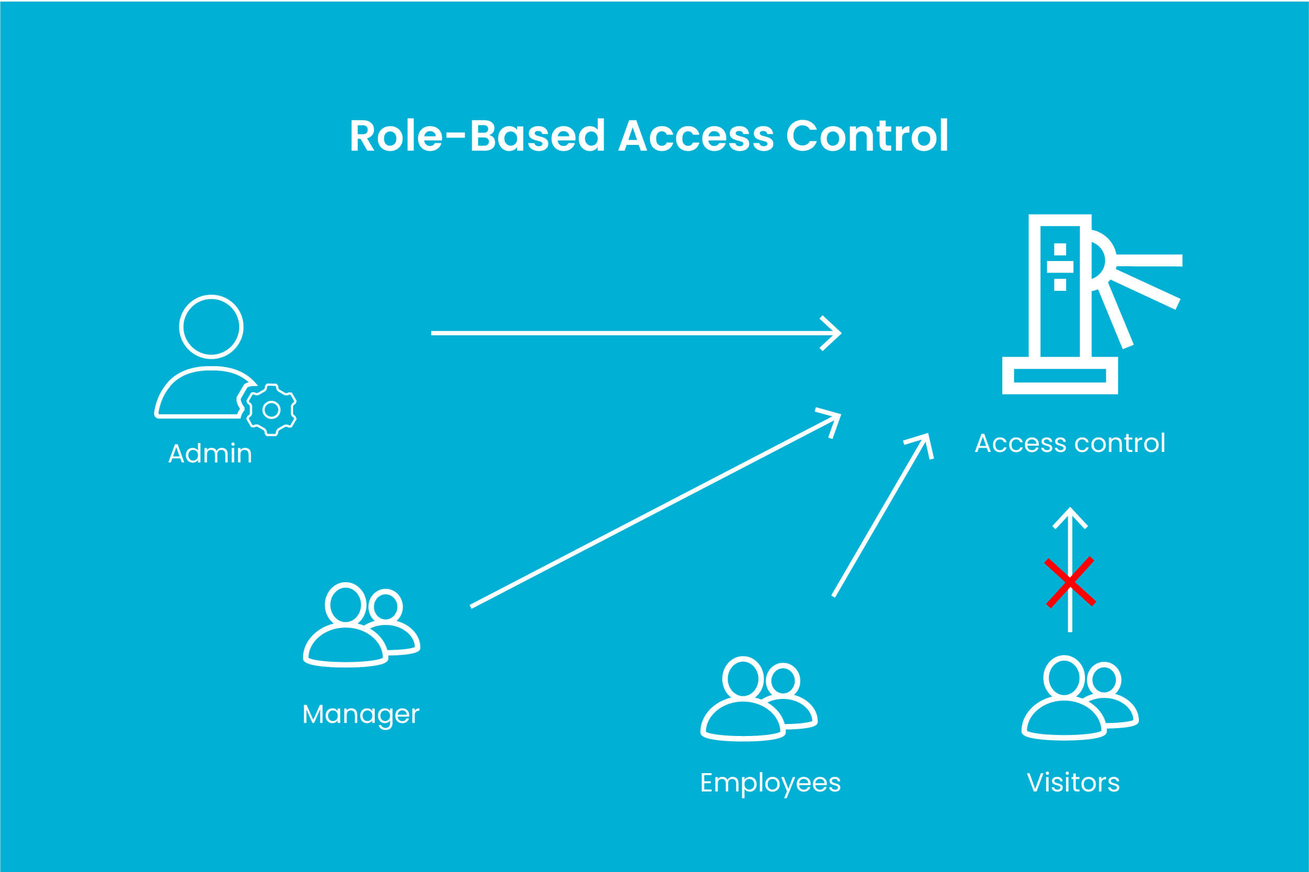
Role Based Access Control (RBAC) Under this category of Access Control Management, access is granted based on the role & responsibility of an individual. In this method, the admin can restrict access to privileged information based on the duties, authority, and job competency of an individual.

Slide 24
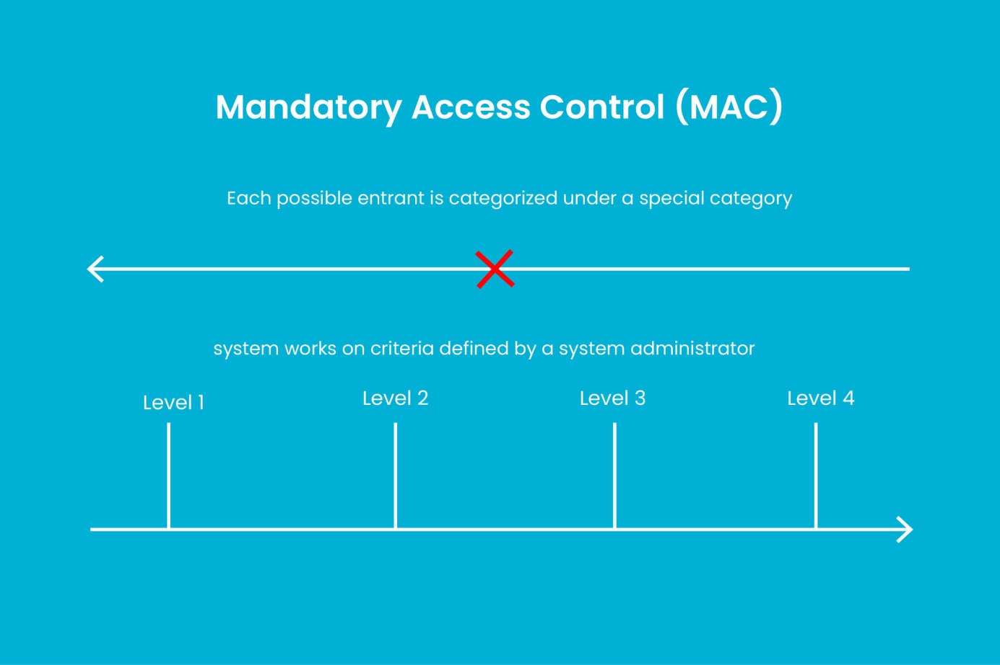
Mandatory Access Control (MAC) Under this category of Access Control Management, an individuals’ ability to grand or deny access is restricted. The system works on criteria defined by a system administrator that is strictly followed by the operating system.

Slide 25
Confidentiality(privacy on algorithm process) Confidentiality refers to ensure that information is not accessed by unauthorized people. Information is intelligible only to its rightful recipients. * Advanced Encryption Standard (AES) is a symmetric key encryption algorithm that supports key lengths of 128, 192, and 256 bits. * AES encrypts a block of bytes at the same time, unlike stream ciphers that encode each single item individually. * The length of the block of data is always 128-bit (16 bytes), while the key size can be: 1.128-bit key size (16 bytes) 2.192-bit key size(24 bytes) 3. 256-bit key size(32 bytes) * As AES is classified as a block cipher algorithm, there are different modes of operation. * A mode of operation describes how to repeatedly apply a cipher's single-block operation to securely transform amounts of data larger than a block.

Slide 26
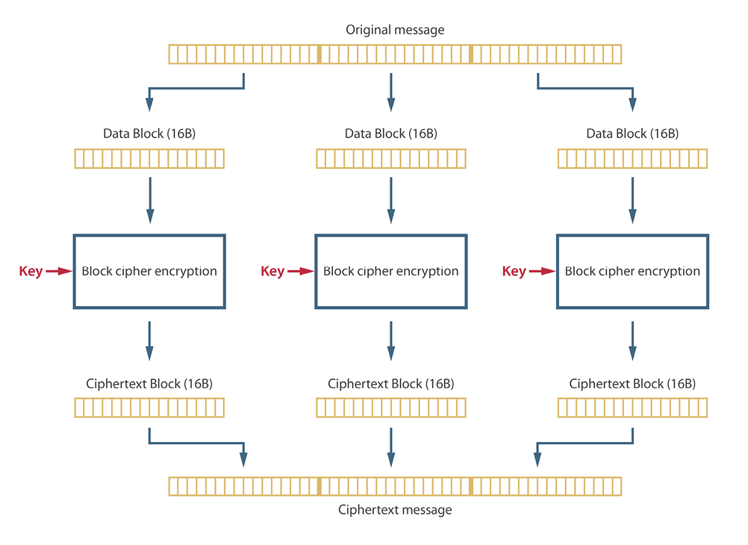
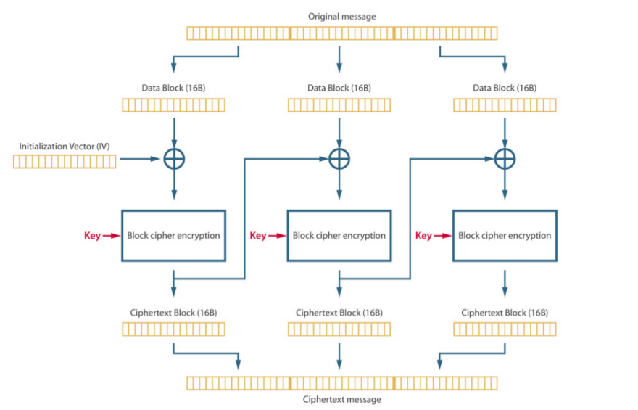
1.] ECB mode: 2.] CBC mode:

Slide 27
Literature Survey/ Related work
Bart Preneel , Vincent Rijmen , Antoon Bosselaers “Design of Conventional Cryptographic Algorithms”, JGRCS - 2011, V2, No.7, PP 1-5
https://www.researchgate.net/publication/2494260_Recent_Developments_in_the_Design_of_Conventional_Cryptographic_Algorithms
https://development.libelium.com/security-programming-guide/confidentiality-privacy
https://www.thesecurepass.com/blog/Types-of-Access-Control-Systems-Management-Pros-and-Cons

Slide 28
4.Comparative analysis and challenges
The RSA stands for Rivest, Shamir, Adleman is named after those who invented it, Ron Rivest, Adi Shamir, and Leonard Adleman.
RSA algorithm is an asymmetric cryptographic algorithm.
It is a public key encryption technique that is widely used for secure data transmission.
AES stands for Advanced Encryption Standard.
AES algorithm is an symmetric encryption algorithm.
It is mainly used for encryption and protection of electronic data.
It was used as the replacement of DES(Data encryption standard) as it is much faster and better than DES

Slide 29
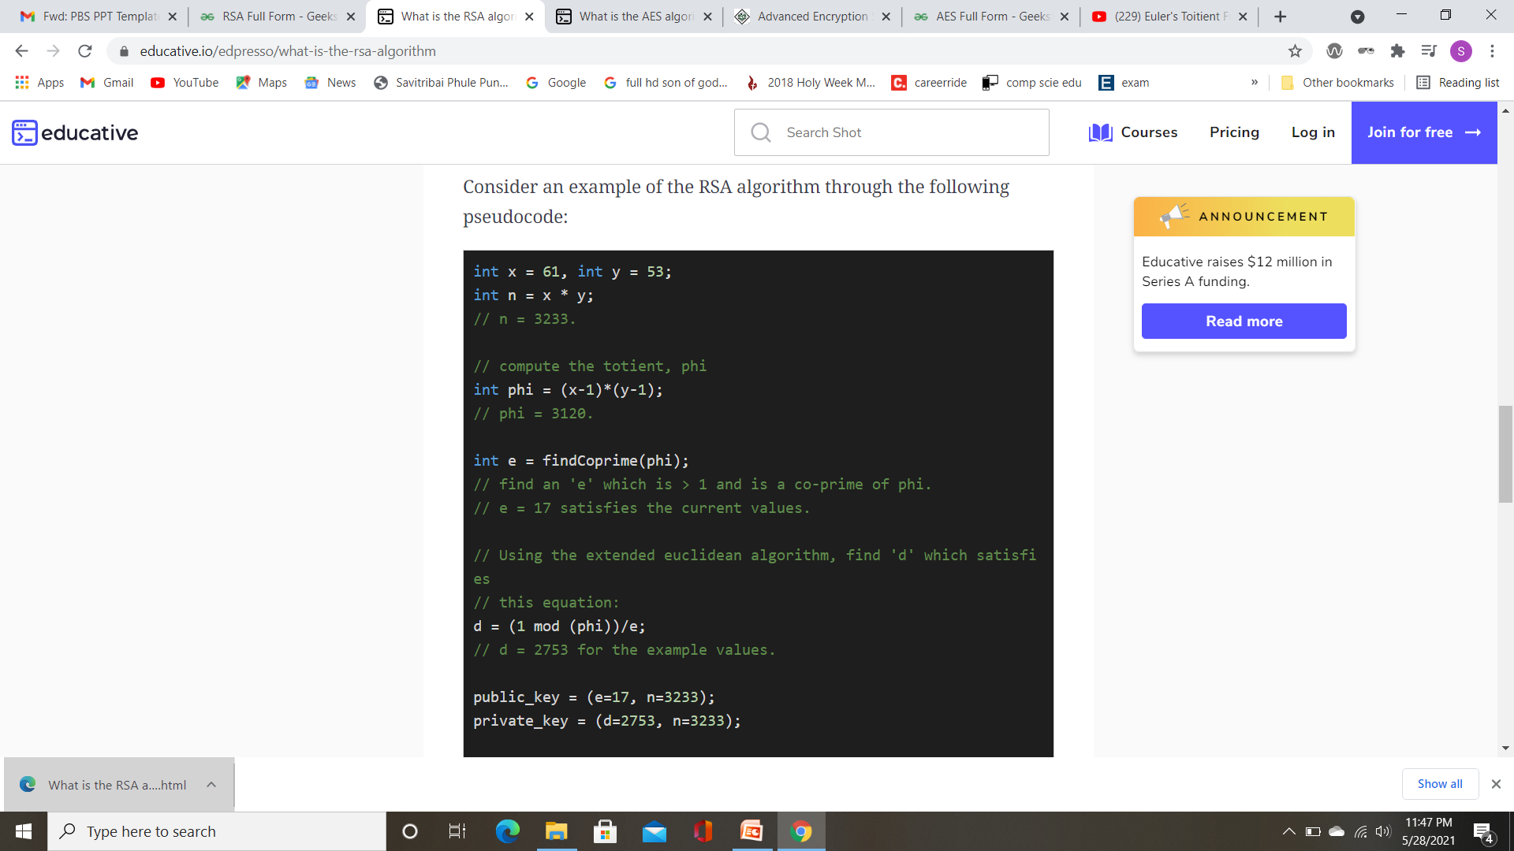
Choose two prime numbers.
Calculate n =x∗y.
Calculate ϕ(n)=(x−1)(y−1) ....[Eulers totient]
Choose value of e
1<e<ϕ(n) & gcd(e, ϕ(n))=1 ie co-prime of phi
Calculate d
ed mod ϕ(n) =1
6. Public key=(e,n)
private key=(d,n)
Key Generation:-
Encryption:-
C=P​^e mod n. ……[P is plain text,C is cipher text]
Decryption:-
P=C​^d mod n.

Slide 30
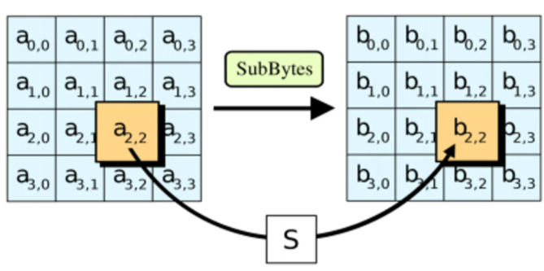
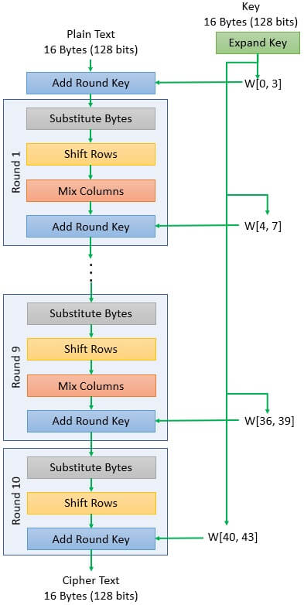
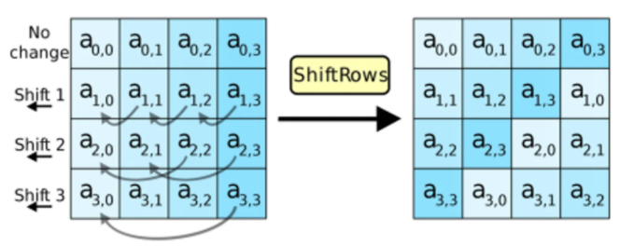
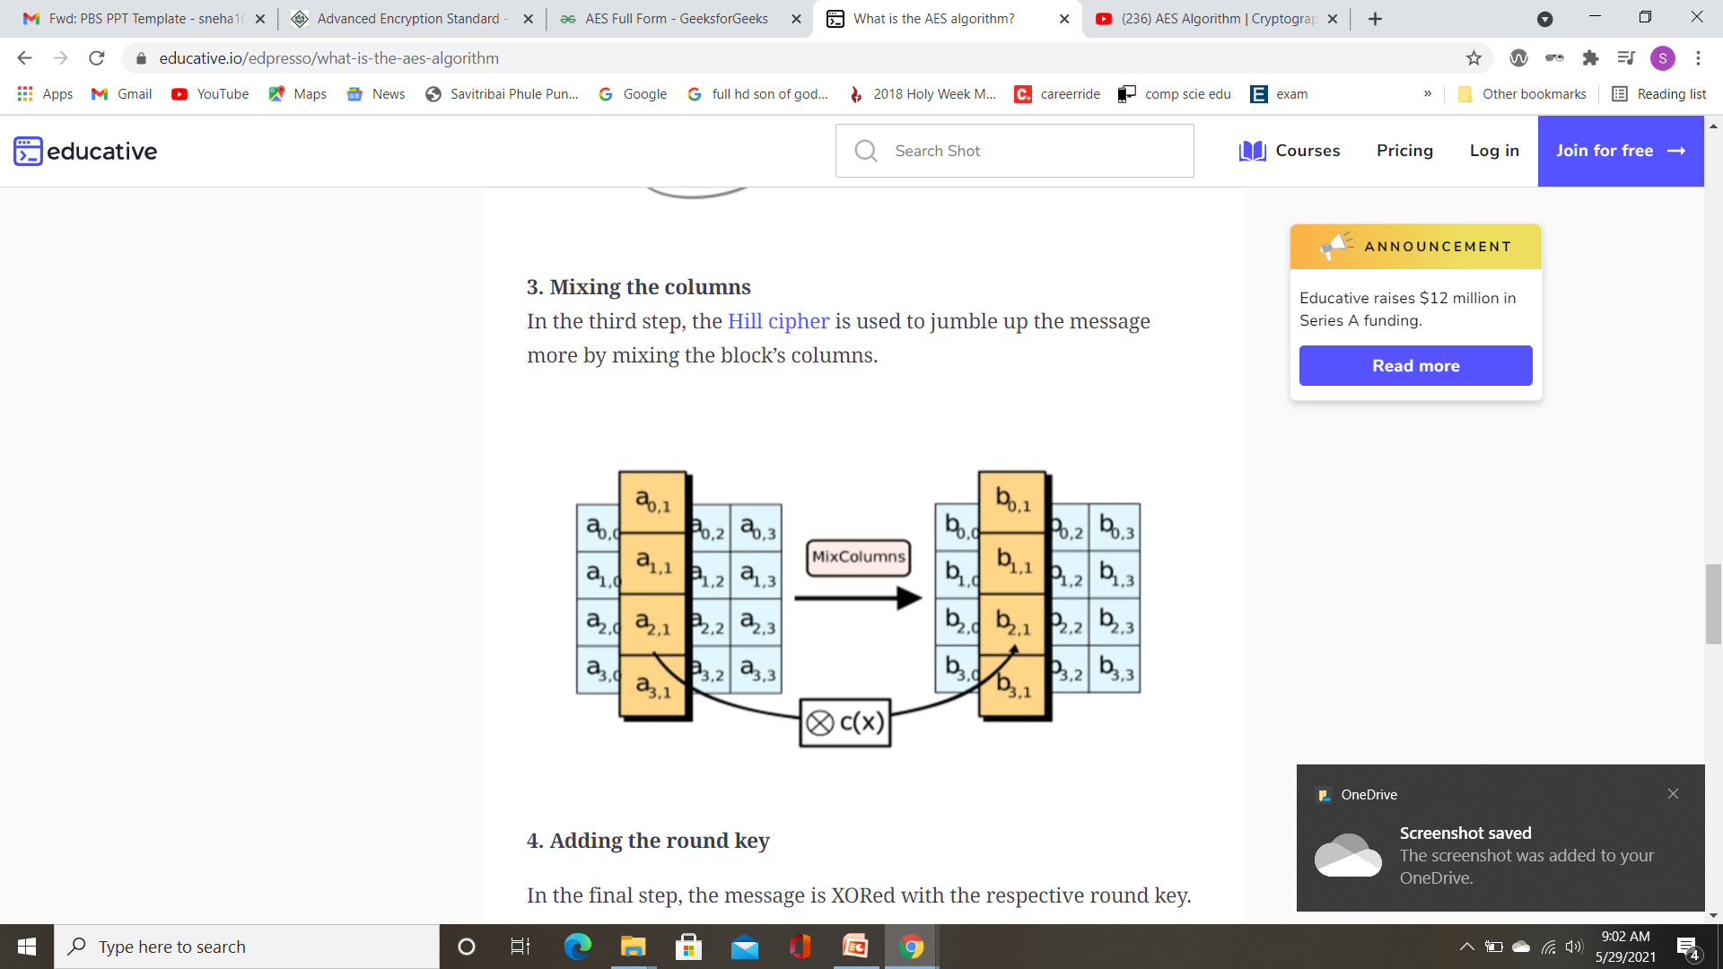
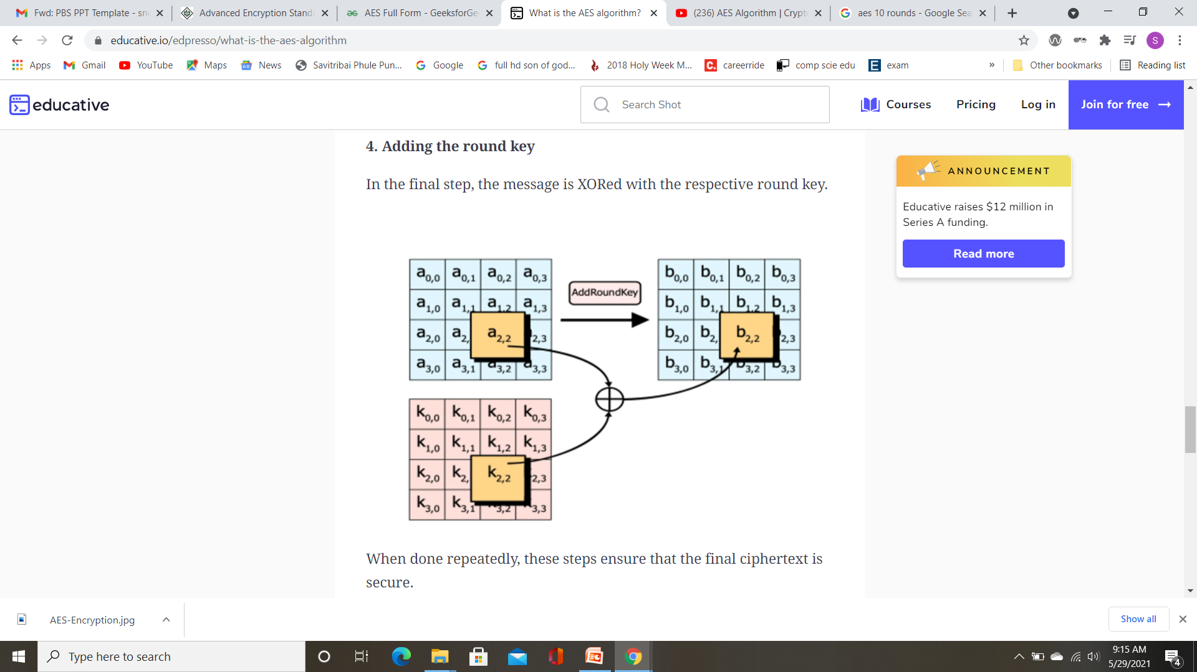
How AES it works?
Substitute Bytes
Shift Rows
Mix Columns
Add round key

Slide 31
Analysis
Sr. No | Features | AES | RSA
1 | Type of cryptography | Symmetric | Asymmetric
2 | Key used | Single (same) key used for encryption and decryption | Different(two) keys used for encryption and Decryption
3 | Throughput | Very high | Low
4 | Key Length | 128,192 bits | >1024 bits
5 | Cipher Block Size | Size 128 bits | Min 512 bits
6 | Confidentiality | High | Low
Hence RSA and AES differ from each other in respect of certain features. Also as we can see AES (Symmetric Algorithm) is more faster and efficient than the RSA (Asymmetric Algorithm).
Therefore we consider it more suitable and light weight. That is why we have decided to use symmetric algorithm.

Slide 32
Literature Survey / Related Work
Antony R, Welch, The Challenge of Comparative Research October 2011 DOI:10.1007/978-90-481-8933-5_17
https://www.geeksforgeeks.org/aes-full-form/
https://www.tutorialspoint.com/cryptography/advanced_encryption_standard.htm
https://www.educative.io/edpresso/what-is-the-rsa-algorithm
https://www.geeksforgeeks.org/rsa-algorithm-cryptography/

Slide 33
Conclusions
The security for data becomes an aspect of importance for any encrypting or decrypting processes.
The space and time are also other important aspects while designing any cipher algorithm. Our method is expects high throughput by occupying less memory.
Considering the planned scheme it is expected to be immune from Brute force attacks as it will require factorial times attacks for cracking the key.
The projected algorithm can be put to use on different types of public applications to transmit confidential data from one machine to another machine.

Slide 34
Thank you !
Questions & Answers

